Slide 1
Exploring Biodiversity & Conservation in National Parks
27/05/2025
Introduction to biodiversity analysis and conservation strategies.
Gabriel Arcangel Bol

Slide 2
Species Data Overview
📌 Dataset: species_info.csv 🔍 Key Insights from Analysis:
Total species analyzed: 5,824
Divided into 7 categories
Most frequent species group: Vascular Plants
Species of Concern is the most common conservation status
Missing values: 5,633 entries in conservation_status
💡 Explanation of dataset purpose and relevance in biodiversity research.

Slide 3

Significance Testing - Endangered Status Analysis
📌 Chi-Square Test for Conservation Status
📊 Statistical test applied:
🔬 Results:
✅ Chi-Square Statistic: 53.916
✅ P-value: 1.89e-05
💡 Interpretation: Since the p-value is very small, we conclude that species categories significantly influence conservation status—some groups are more vulnerable than others.

Slide 4
Conservation Recommendations
📌 Strategies for Conservation Efforts 🔍 Based on findings, we recommend:
Prioritizing birds and vascular plants as they are at higher risk.
Monitoring "Species of Concern" to prevent them from becoming endangered.
Preserving ecosystems for mammals like Puma concolor and Procyon lotor, which show adaptability.
Implementing stronger biodiversity policies based on species observation trends.
💡 Science-based recommendations to enhance conservation programs.

Slide 5
Visual Representations
📌 Graphs & Key Observations:
Conservation status distribution
Endangered species trends by category
Most observed species per park
Top 5 most observed species per park
Sample size determination for foot and mouth disease

Slide 6
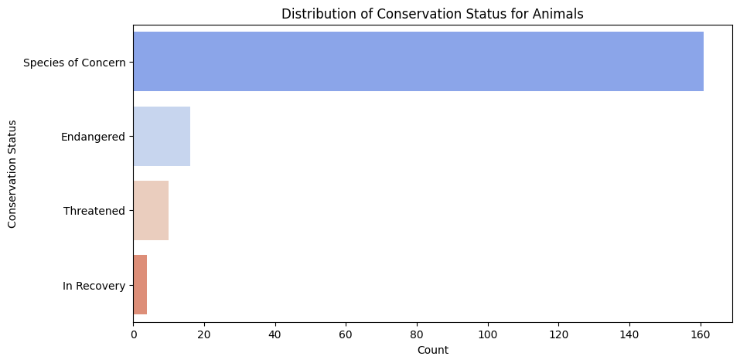
Conservation status distribution
📌 Key Insights
Species of Concern is the most frequent conservation status.
Fewer species are classified as Endangered, Threatened, or In Recovery.
Chi-square analysis confirms significant differences in conservation status among species groups.

Slide 7
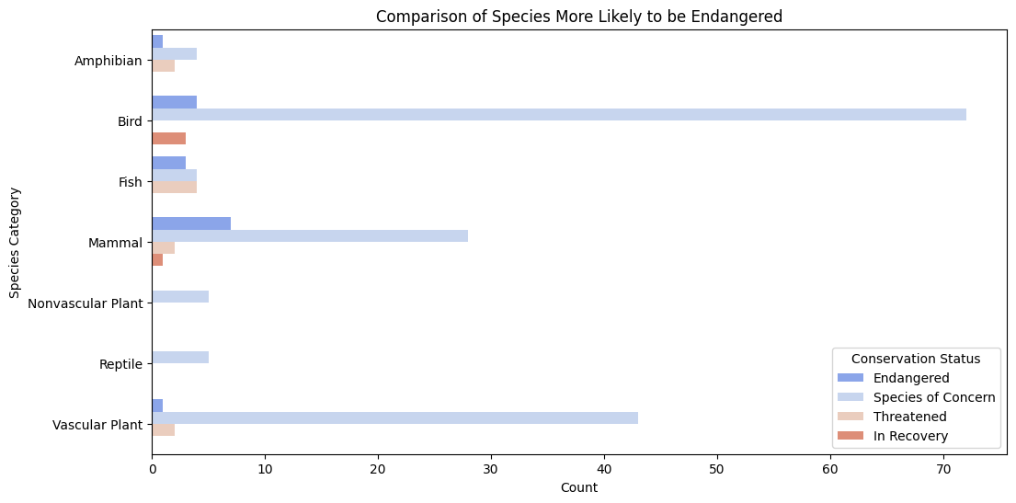
Endangered species trends by category
📌 Key Insights
Birds and vascular plants have the highest number of endangered species.
Mammals also show notable presence in endangered categories.
Reptiles, amphibians, and fish show lower counts in endangered status.
Chi-square test reinforces the vulnerability trend among species groups.

Slide 8
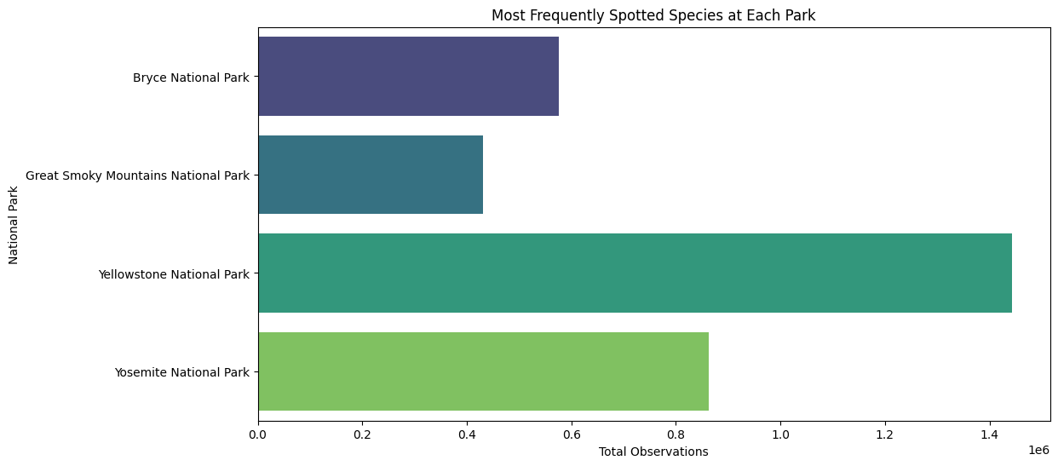
Most observed species per park
📌 Key Insights
Holcus lanatus had the highest recorded observations in Yellowstone (805 sightings).
Streptopelia decaocto appears frequently across multiple parks, showing adaptability.
Puma concolor and Procyon lotor demonstrate habitat flexibility, appearing in various locations.
Castor canadensis and Hypochaeris radicata are seen in multiple parks, indicating widespread distribution.
Certain species are highly localized, while others are found across different ecosystems.
💡 Takeaway: Understanding species distribution is essential for conservation planning—widely spread species require habitat preservation, while localized species need targeted interventions.

Slide 9
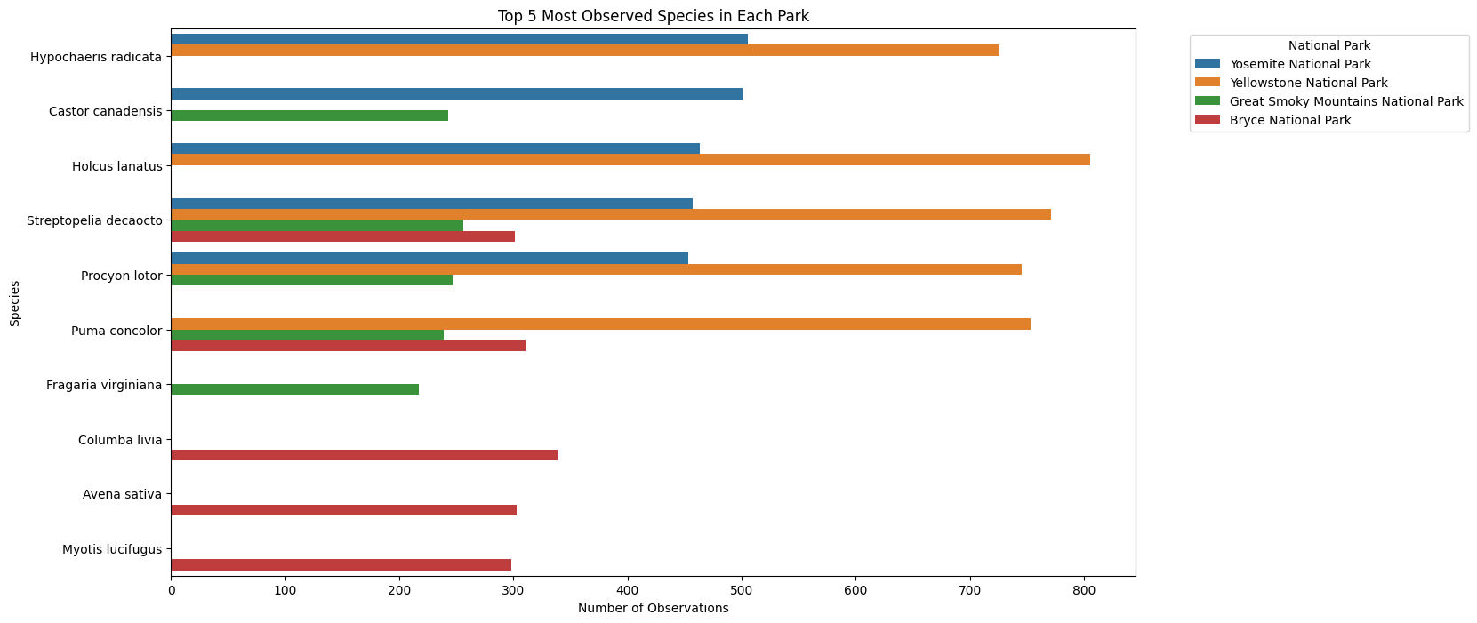
Top 5 - Most observed species per park
📌 Key Insights
Streptopelia decaocto appears frequently across multiple parks, showing adaptability.
Puma concolor and Procyon lotor are widely distributed across different environments.
Holcus lanatus had the highest recorded observations in Yellowstone (805 sightings).
Some species appear localized, while others thrive across multiple national parks.

Slide 10

Sample Size Determination - Foot and Mouth Disease Study
📌 Sample Size Calculation for Disease Monitoring
🔬 Formula applied:
📊 Study parameters:
✅ Z-score: 1.96 (95% confidence level)
✅ Estimated prevalence: 5%
✅ Margin of error: 5%
📌 Results
Required Sample Size (without adjustment): 73
Adjusted Sample Size (with population correction): 73
💡 Ensures an accurate estimate for epidemiological studies.

Slide 11
Key Findings & Takeaways
📌 Summary of Results & Next Steps
✅ Data confirms high-risk species require conservation priority.
✅ Statistical analysis supports informed environmental policies.
✅ Sample size calculation ensures reliable disease monitoring methodology.
🎯 Future Research Directions:
📊 Investigate environmental factors affecting species survival.
🔍 Develop predictive models for conservation and disease prevention.

